Slide 1
Non-Specific Defences

Slide 2
Defenses against disease
Most pathogenic organisms are never able to enter the body, and if they do they are destroyed before they cause symptoms of disease.
Our bodies defense system against pathogens can be broken down into two categories, non-specific defense and specific defense.
This PowerPoint will focus on NON-SPECIFIC defense.

Slide 3
Non-specific defences
Non-specific defenses are our bodies first line of defense. They are, as the name suggests, non-specific meaning they work against all pathogens.
Non-specific defenses can be either external or internal defenses. These include:
External
Skin
Mucous membranes
Hairs
Cilia
Acids
Lysozyme
Cerumen
Flushing action
Internal
Phagocytes
Leucocytes
Macrophages
Inflammation
Fever

Slide 4
External non-specific defences
Skin
Physical barrier between the internal and external environment of the body. It is difficult for pathogens to become established on the skin as it is continually occupied by other bacteria.
Secretes sebum, an oily fluid that can kill pathogens.
Fatty acids and salts in sweat also prevents micro-organisms from growing.
Mucous membranes
Line body cavities and secrete mucous which prevents entry of pathogens into the body.

Slide 5
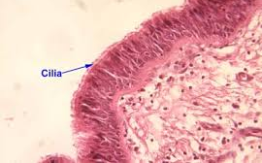
External non-specific defences cont.
Hairs
Used to trap particles and prevent them moving through respiratory system.
Cilia
Tiny hairs which move with a beating motion. Their role is to move mucous containing trapped micro-organisms to the throat.

Slide 6
External non-specific defences cont.
Acids
Acidic fluids which can destroy micro-organisms. E.g. stomach juices, acidic secretions from the vagina and also sweat.
Lysozyme
Bacteria killing enzyme. Found in tear, sweat, saliva and secretions of nose and tissue fluid.
Cerumen (ear wax)
Slightly acidic and contains lysozymes, protecting the outer ear.

Slide 7
External non-specific defences cont.
Flushing action
Movement of fluids prevent pathogens from infecting the body.
Examples include tears, sweat, saliva and the movement of urine through the urethra to be expelled.
Can prevent bladder or kidney infections so bacteria cannot move up urethra.

Slide 8
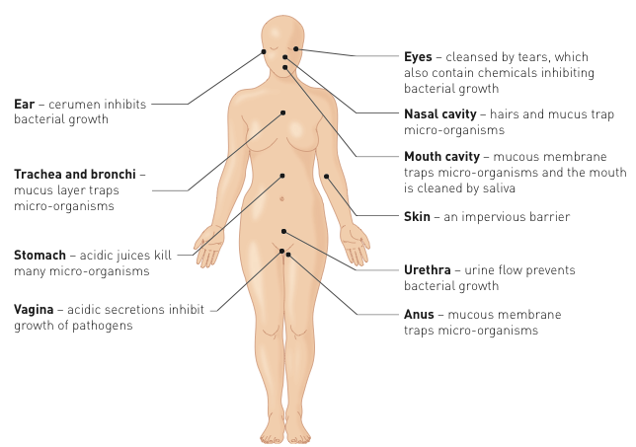
Summary External non-specific defences

Slide 9
Protective reflexes
Automatic response to a stimulus with the goal of protecting the body. Protective reflexes include:
Sneezing
Coughing
Vomiting
Diarrhoea

Slide 10
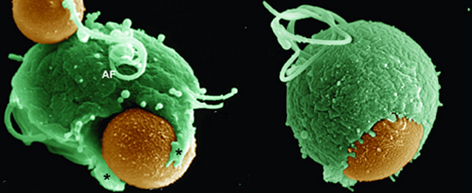
Internal non-specific defenses
Phagocytes
cells which engulf and digest micro-organisms

Slide 11
Internal non-specific defenses cont.
Two main types of phagocytes involved in non-specific defense
Leucocytes
Have the ability to leave the blood capillaries and migrate through tissues to the place of infection. Can secrete substances to kill bacteria before they engulf them.
Macrophages
Develop from some leucocytes. Can be either fixed in one place waiting for bacteria to come to them or some can wander.

Slide 12
Internal non-specific defenses cont.
Phagocytosis video
http://highered.mheducation.com/sites/0072495855/student_view0/chapter2/animation__phagocytosis.html

Slide 13
Internal non-specific defenses cont.
Inflammation
A typical inflammatory response will show the signs of redness, swelling and heat and pain.
These occur as a result of the process which occurs in response to an infection.
In your text book (pg 136), read and summarise in dot points/flowchart the seven steps involved in the inflammatory response. Highlight/underline key terms such as mast cells, histamine, heparin etc.
Non-specific inflammatory response animation

Slide 14
Internal non-specific defenses cont.
Fever
An elevation of body temperature caused by an increase in the body’s thermostat (controlled by the hypothalamus)
Increased body temperature will:
Inhibit growth of some bacteria and viruses.
Speed up the rate of chemical reactions, allowing cells to repair themselves at a faster rate.
Pyrogens – chemicals released by white blood cells during inflammatory response which act directly on hypothalamus, causing it to lower body temperature.

Slide 15
Lymphatic System
Lymph fluid will carry pathogens to lymph nodes
The lymph nodes form a mesh which traps in bacteria and foreign micro-organisms.
This allow macrophages to come into lymph node and engulf and destroy the pathogen

Slide 16
Helping the body’s non-specific defense
Good Hygiene
Wash hands
Cover mouth
Wear gloves
Wipe surfaces
Use tongs, tweezers, pliers
No sharing
Mechanical Barriers
Obstacles for invading pathogens e.g. face masks protective clothing, gloves, safety glasses, condoms

